Slide 1
Chapter 6 Subquery and CTE

Slide 2
What Is a Subquery?
A subquery is a SELECT statement embedded in a clause of another SQL statement.
Main
Query
SELECT . . .
FROM . . .
WHERE . . .
(SELECT . . .
FROM . . .
WHERE . . .)
Subquery

Slide 3

Subqueries
The subquery (inner query) executes once before the main query.
The result of the subquery is used by the main query (outer query).
Each time the outer query is processed, the inner query is evaluated

Slide 4
Guidelines for Using Subqueries
Enclose subqueries in parentheses.
Place subqueries on the right side of the comparison condition.
The ORDER BY clause in the subquery is not needed.
Use single-row operators with single-row subqueries, and use multiple-row operators with multiple-row subqueries.

Slide 5
Types of Subqueries
Single-row subquery
Multiple-row subquery
Main query
Subquery
returns
SR1
Main query
returns
MR1
MR2
.
.
.
Subquery

Slide 6
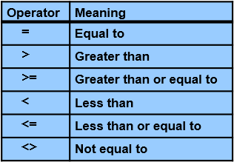
Single-Row Subqueries
Return only one result to the outer query
Use single-row comparison operators

Slide 7

Executing Single-Row Subqueries in the WHERE clause – Scalar Subquery
Display the ID and the Name of the employee who gets the maximum salary value.
select ID, Name
from Employee
where Salary =
(select MAX(salary) from employee)

Slide 8

Nested subqueries
Display the name and the salary for those who their salary is > the
minimum salary in the IT department or depart_ID=1. Sort the results by salary desc
select name, salary
from Employee
where Depart_ID =
(select Depart_ID from Employee where Depart_ID =1 group by Depart_ID)
and
Salary > (select Salary from Employee where salary =
(select Min (salary) from employee where Depart_ID=1))
order by salary desc

Slide 9
Single-Row Subqueries in the HAVING Clause
Nested query can be complex, so simplify as much as you can
select name, Max(salary) AS Salary
from Employee
where depart_ID=1
group by Name
having Max(salary) > (Select Min(Salary) from employee where Depart_ID=1)
order by Salary desc
OR….

Slide 10
Nested subqueries, Continue
Select Name, Salary
from Employee
where Depart_ID = 1 and
salary > (Select Min(Salary) from employee where Depart_ID=1)
order by salary desc
OR....

Slide 11
Nested subqueries, Continue
This query can be written like:
select top (3)name, Salary
from Employee
where Depart_ID = 1
order by Salary desc
Either way you will get the same result, and that is the beauty of SQL

Slide 12
Single-Row Subquery in a SELECT Clause
Ex:
select Name, Salary, (select AVG(salary) from Employee) AS "Overall Avg"
from employee

Slide 13
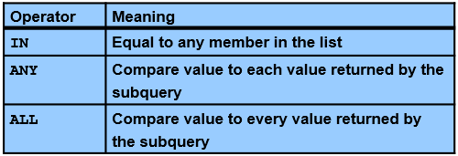
Multiple-Row Subqueries
Return more than one row of results
Use multiple-row comparison operators

Slide 14
Multiple-Row Subqueries in the WHERE clause
Subquery that return more than 1 row result
Ex:
select name, salary
from Employee
where Depart_ID in
(select ID from Department)

Slide 15
Multiple-Row Subqueries in the FROM clause
Ex:
Select Name, Salary
from (Select * from Employee) AS Sub

Slide 16
Multiple-Row Subqueries in the FROM clause – utilizing join + nested query
Display the Departments that has 2 or more employees work in each department
SELECT DepartName, COUNT (*) AS "Number of Employee"
FROM DEPARTMENT, (select * from employee) AS Sub
WHERE department.ID=Depart_ID --AND SALARY > 4000
AND department.ID IN ( SELECT Depart_ID FROM Employee GROUP BY Depart_ID HAVING COUNT (*) >= 2 )
GROUP BY DepartName
Rewrite it without subquery…

Slide 17
Multiple-Row Subqueries in the SELECT clause
Display a list of department name and the number of working employee in each department
select departname, (select count(*) from employee where Depart_ID = Department.ID) AS "Number of Employee"
from Department

Slide 18
CTE. Common Table Expression
CTE, are a new construct introduced in Microsoft SQL Server 2005 that offer a more readable form of the derived table that can be declared once and referenced multiple times in a query
is a temporary named result set that you can reference within a SELECT, INSERT, UPDATE, or DELETE statement that immediately follows the CTE
allows us to define a temporary, view-like construct
There are two types of CTEs—recursive and nonrecursive.
Syntax:
WITH <CTEName> ( <column-list> Optional)
AS
( <CTE>)
<SELECT using CTE>

Slide 19
CTE, Cont.
you can construct multiple CTE by adding a comma between them
A nonrecursive CTE is one that does not reference itself within the CTE.
VS
A recursive CTE is one that references itself within that CTE.
The recursive CTE is useful when working with hierarchical data because the CTE continues to execute until the query returns the entire hierarchy.
A recursive CTE must contain at least 2 queries, An anchor member and a recursive member connected by Union All

